Slide 1
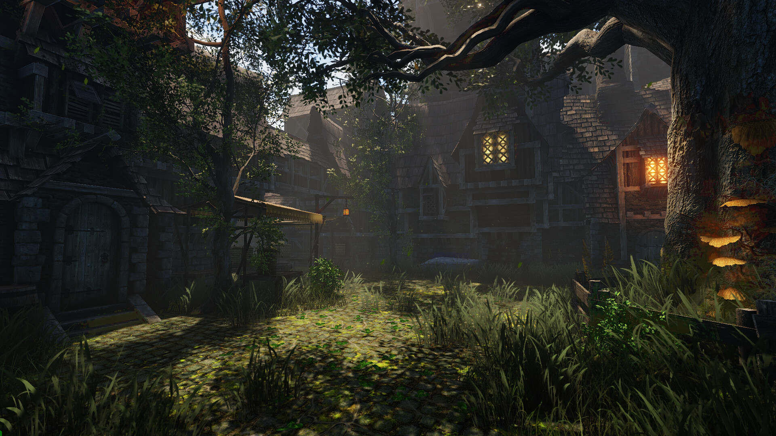
MENTOR
PLAYER
DEVELOPER

Slide 2





CHOOSE YOUR AVATAR

Slide 3
USERNAME
PASSWORD
SIGN IN
NEW USER? SIGN UP.

Slide 4
USERNAME
PASSWORD
SIGN IN
NEW USER? SIGN UP.

Slide 5
NAME:
AGE:
EMAIL ID:
USER NAME:
PASSWORD:
PASSWORD:
SUBMIT

Slide 6
YOU WILL SOON
RECEIVE A CONFIRMATION
EMAIL WHEN YOUR
ID IS APPROVED!
NAME:
AGE:
EMAIL ID:
USER NAME:
PASSWORD:
PASSWORD:
SUBMIT

Slide 7
MENTOR
ANUSHA CHATURVEDI
i
MAY2020
S M T W T F S
1 2
3 4 5 6 7 8 9
10 11 12 13 14 15 16
17 18 19 20 21 22 23
24 25 26 27 28 29 30
31
+

Slide 8
MENTOR
ANUSHA CHATURVEDI
i
MAY2020
PREVIOUS
TESTS
UPCOMING
TEST
S M T W T F S
1 2
3 4 5 6 7 8 9
10 11 12 13 14 15 16
17 18 19 20 21 22 23
24 25 26 27 28 29 30
31
+

Slide 9
MENTOR
ANUSHA CHATURVEDI
i
MAY2020
S M T W T F S
1 2
3 4 5 6 7 8 9
10 11 12 13 14 15 16
17 18 19 20 21 22 23
24 25 26 27 28 29 30
31

Slide 10
MENTOR
ANUSHA CHATURVEDI
i
MAY2020
SELECT
THE
DATE
S M T W T F S
1 2
3 4 5 6 7 8 9
10 11 12 13 14 15 16
17 18 19 20 21 22 23
24 25 26 27 28 29 30
31

Slide 11
MENTOR
ANUSHA CHATURVEDI
i
21st May, 2020.
INVIGILATORS:
NUMBER OF STUDENTS:
DURATION OF THE TEST: 1.5 HOURS
SUBMIT

Slide 12
MENTOR
ANUSHA CHATURVEDI
i
ENTER
THE
DETAILS
21st May, 2020.
INVIGILATORS:
NUMBER OF STUDENTS:
DURATION OF THE TEST: 1.5 HOURS
CODE: ABA12
SUBMIT

Slide 13
MENTOR
ANUSHA CHATURVEDI
i
MAY2020
S M T W T F S
1 2
3 4 5 6 7 8 9
10 11 12 13 14 15 16
17 18 19 20 21 22 23
24 25 26 27 28 29 30
31
+

Slide 14

MENTOR
ANUSHA CHATURVEDI
i
15th May, 2020.
INVIGILATORS:
NUMBER OF STUDENTS: 15
DURATION OF THE TEST: 1.5 HOURS
VIEW STUDENT REPORT

Slide 15
MENTOR
ANUSHA CHATURVEDI
i
15th May, 2020.
SL No NAME RESULT
1 ABC 90
2 Athena M Lobo 90
3 Benny Dharshan 90
4 Lakshay Mittal 100
5 Anvita vegas 90

Slide 16
MENTOR
ANUSHA CHATURVEDI
i
15th May, 2020.
ABC
LEVEL 1
Tower of Hanoi
LEVEL 2
Tower of Hanoi
LEVEL 3
Tower of Hanoi
LEVEL 4
Tower of Hanoi
LEVEL 5
Tower of Hanoi
LEVEL 6
Tower of Hanoi
LEVEL 7
Tower of Hanoi
LEVEL 8
Tower of Hanoi
LEVEL 9
Tower of Hanoi
LEVEL 10
Tower of Hanoi
LEVEL 11
Tower of Hanoi
LEVEL 12
Tower of Hanoi

Slide 17
MENTOR
ANUSHA CHATURVEDI
i
100
90
80
70
60
50
40
30
20
10
0
100
100
90
80
PERCENTAGE
70
60
LOGICAL
REASONING
PATTERN
RECOGNITION
INDUCTIVE
THINKING
INDUCTIVE
THINKING
CATEGORY
FORMATION
WORKING
MEMORY
SKILLS

Slide 18
MENTOR
ANUSHA CHATURVEDI
FINAL RESULT
Average score required - 65
ABC’s score - 90
ABC has performed exceedingly well! She/he can definitely have a bright future in coding.
Score analysis

Slide 19
MENTOR
ANUSHA CHATURVEDI
SCORE RESULT
100-90 Perfect fit for coding
90-60 Great coder
60-40 Could still have a future with practice
40-0 Preferably look for another career option

Slide 20
MENTOR
ANUSHA CHATURVEDI
i
MAY2020
S M T W T F S
1 2
3 4 5 6 7 8 9
10 11 12 13 14 15 16
17 18 19 20 21 22 23
24 25 26 27 28 29 30
31
+

Slide 21
MENTOR
ANUSHA CHATURVEDI
i
CHANGE PROFILE
PICTURE
TESTS INVIGILATED
LOG OUT
MAY2020
S M T W T F S
1 2
3 4 5 6 7 8 9
10 11 12 13 14 15 16
17 18 19 20 21 22 23
24 25 26 27 28 29 30
31
+

Slide 22
DEVELOPER
ANUSHA CHATURVEDI
i
LEVEL 1
Tower of Hanoi
LEVEL 2
Tower of Hanoi
LEVEL 3
Tower of Hanoi
LEVEL 4
Tower of Hanoi
LEVEL 5
Tower of Hanoi
LEVEL 6
Tower of Hanoi
LEVEL 7
Tower of Hanoi
LEVEL 8
Tower of Hanoi
LEVEL 9
Tower of Hanoi
LEVEL 10
Tower of Hanoi
LEVEL 11
Tower of Hanoi
LEVEL 12
Tower of Hanoi
+

Slide 23
DEVELOPER
ANUSHA CHATURVEDI
i
SELECT THE GAME
TO EDIT OR ADD A NEW LEVEL.
LEVEL 1
Tower of Hanoi
LEVEL 2
Tower of Hanoi
LEVEL 3
Tower of Hanoi
LEVEL 4
Tower of Hanoi
LEVEL 5
Tower of Hanoi
LEVEL 6
Tower of Hanoi
LEVEL 7
Tower of Hanoi
LEVEL 8
Tower of Hanoi
LEVEL 9
Tower of Hanoi
LEVEL 10
Tower of Hanoi
LEVEL 11
Tower of Hanoi
LEVEL 12
Tower of Hanoi
+

Slide 24
DEVELOPER
ANUSHA CHATURVEDI
i
LEVEL 1-TOWER OF HANOI
Description: Transfer all the boxes from log ‘A’ to log ‘B’, one box
at a time.
Criteria: Number of moves.
Skills: Working memory, logical reasoning and pattern recognition.
Time:

Slide 25
DEVELOPER
ANUSHA CHATURVEDI
i
LEVEL 1
LEVEL 2
Tower of Hanoi
LEVEL 3
Tower of Hanoi
LEVEL 4
Tower of Hanoi
LEVEL 5
Tower of Hanoi
LEVEL 6
Tower of Hanoi
LEVEL 7
Tower of Hanoi
LEVEL 8
Tower of Hanoi
LEVEL 9
Tower of Hanoi
LEVEL 10
Tower of Hanoi
LEVEL 11
Tower of Hanoi
LEVEL 12
Tower of Hanoi
+

Slide 26
DEVELOPER
ANUSHA CHATURVEDI
i
LEVEL 1-NO GAME
Description:
Criteria:
Skills:
Time:
ENTER

Slide 27
DEVELOPER
ANUSHA CHATURVEDI
i
LEVEL 13-NO GAME
Description:
Criteria:
Skills:
Time:
ENTER

Slide 28
DEVELOPER
ANUSHA CHATURVEDI
i
LEVEL 1
Tower of Hanoi
LEVEL 2
Tower of Hanoi
LEVEL 3
Tower of Hanoi
LEVEL 4
Tower of Hanoi
LEVEL 5
Tower of Hanoi
LEVEL 6
Tower of Hanoi
LEVEL 7
Tower of Hanoi
LEVEL 8
Tower of Hanoi
LEVEL 9
Tower of Hanoi
LEVEL 10
Tower of Hanoi
LEVEL 11
Tower of Hanoi
LEVEL 12
Tower of Hanoi
+

Slide 29
DEVELOPER
ANUSHA CHATURVEDI
i
CHANGE PROFILE PICTURE
LOG OUT
LEVEL 1
Tower of Hanoi
LEVEL 2
Tower of Hanoi
LEVEL 3
Tower of Hanoi
LEVEL 4
Tower of Hanoi
LEVEL 5
Tower of Hanoi
LEVEL 6
Tower of Hanoi
LEVEL 7
Tower of Hanoi
LEVEL 8
Tower of Hanoi
LEVEL 9
Tower of Hanoi
LEVEL 10
Tower of Hanoi
LEVEL 11
Tower of Hanoi
LEVEL 12
Tower of Hanoi
+

Slide 30





WELCOME!
USERNAME
LET’S PLAY

Slide 31
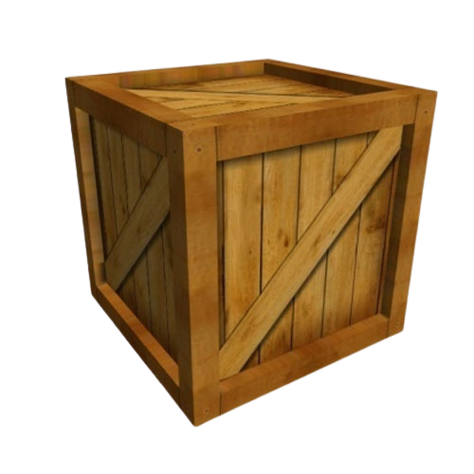
ENTER THE CODE
GIVEN CODE
ENTER

Slide 32
Let’s get to know each other!

Slide 33
Hi, I’m Coco!
C

Slide 34
What’s your-
Name:
Age:
Highest Qualification:

Slide 35
Are you-
Good with math? YES/NO
Color blind? YES/NO

Slide 36
Can you play-
Chess
Solitaire
Rummy
Sudoku
None of the Above

Slide 37
WELCOME!
ENTER YOUR USERNAME
LET’S PLAY

Slide 38

1
3
5
7
2
4
6
8

Slide 39

1
COUNT THE
NUMBER OF
TRIANGLES

Slide 40

1
1
2

Slide 41

1
NUMBER OF TRIANGLES:
?
20

Slide 42


AWESOME!!!

Slide 43

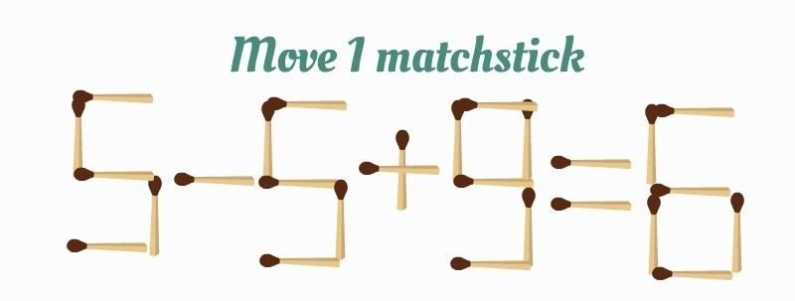
2

Slide 44
2
?

Slide 45
2
#Slide 1
?

Slide 46
NICE!

Slide 47

3
MEASURING THE
MAGIC
POTION!

Slide 48
3
HELP ME POUR
TWO LITERS OF MY
MAGIC POTION INTO
THE MAGICAL POT!
USE THE 5 LITER AND
3 LITER GLASS TO
MEASURE EXACTLY 2
LITERS OF
THE MAGIC POTION.
5L
3L
2L

Slide 49
3
FILL
EMPTY
TRANSFER FROM
TRANSFER TO
5L
3L
2L
YOU CAN FILL THE
MAGIC POTION:
YOU CAN EMPTY
THE MAGIC POTION:
WHEN YOU GET
2 LITERS, TRANSFER
TO THE MAGICAL POT.
YOU CAN TRANSFER
THE MAGIC POTION:
5L
3L
2L

Slide 50

3
FILL
EMPTY
TRANSFER TO
TRANSFER FROM
5L
3L
2L
5L
3L
2L
?

Slide 51
AWESOME!!!

Slide 52

4
MAGIC
S UARES

Slide 53

4
A MAGIC SQUARE IS A SQUARE IN WHICH,
THE SUM OF EACH ROW,
THE SUM OF EACH COLUMN AND,
THE SUM OF EACH DIAGONOL
IS THE SAME.
36
13
36
8
15
36
14
12
10
9
16
11
36
36
36
36
36
36

Slide 54
4
FILL UP THE EMPTY SPACES
IN THE FOLLOWING MAGIC
SQUARES:

Slide 55
4
2:00
2
7
6
9
5
1
4
3
8
?
NEXT

Slide 56
4
1:40
10
3
8
5
7
9
6
11
4
?
NEXT

Slide 57
4
1:10
8
1
6
3
5
7
4
9
2
?
NEXT

Slide 58
4
0:45
8
2
6
3
7
7
4
1
5
?
NEXT

Slide 59
4
0:05
17
10
15
12
14
16
13
18
11
?
NEXT

Slide 60
NICE!

Slide 61



5
LARGEST AND SMALLEST
PRODUCT

Slide 62
5
USE THESE DIGITS
4
0
2
6
TO FORM TWO NUMBERS THAT RESULT IN THE:
LARGEST PRODUCT
SMALLEST PRODUCT
AND
62
*
40
04
*
26

Slide 63
5
9
1
5
2
LARGEST PRODUCT
SMALLEST PRODUCT
91
52
29
*
15
?
*

Slide 64
GREAT!!

Slide 65

6
GEARS

Slide 66
6
PREDICT THE DIRECTION OF
ROTATION OF THE REQUIRED GEAR,
GIVEN THE DIRECTION OF THE FIRST
GEAR.

Slide 67
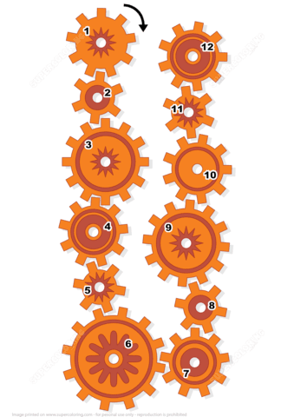
6
12
12
?

Slide 68
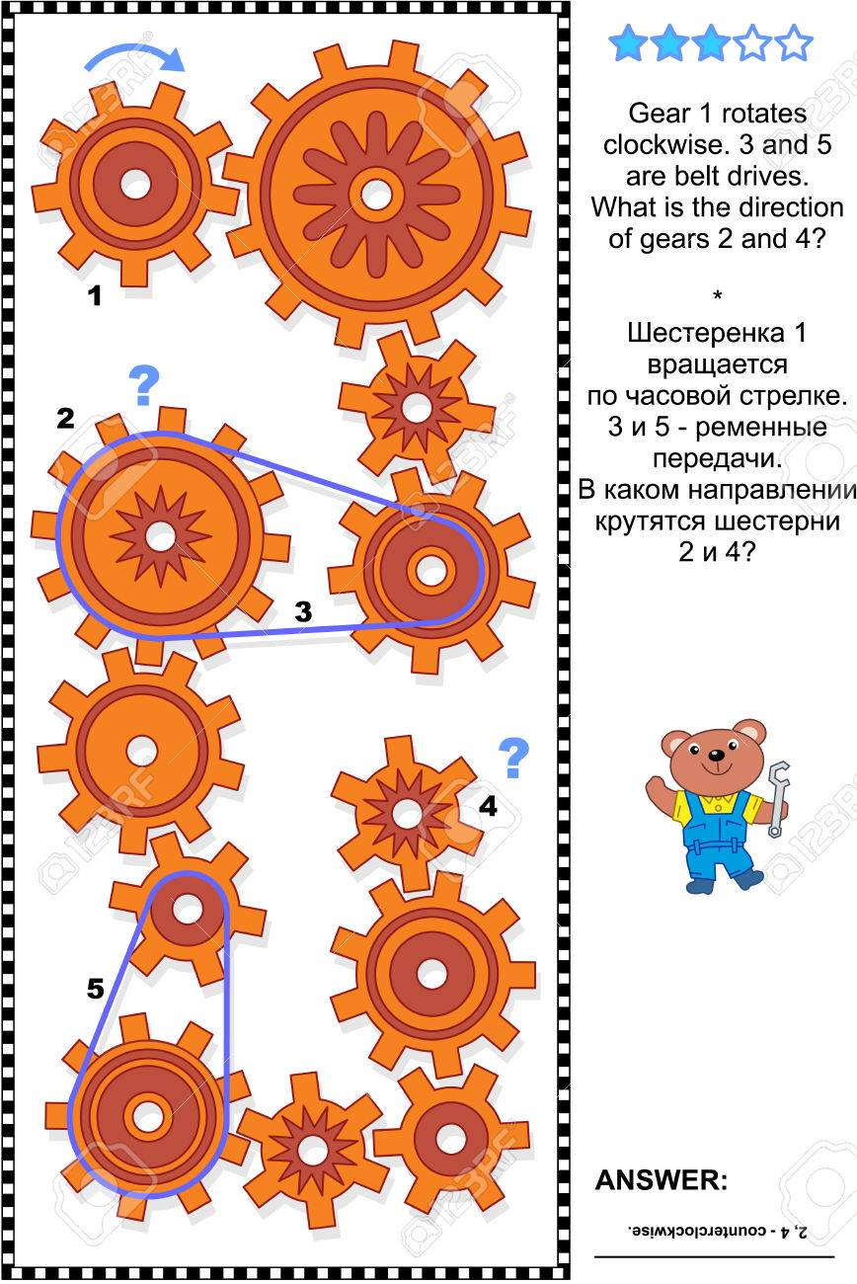
6
4
4
?

Slide 69
GREAT!!

Slide 70

7
TOWER
OF
HANOI

Slide 71
7
A
B
C
ONLY A SMALLER BOX
CAN BE PLACED ON TOP
OF A BIGGER BOX

Slide 72

7
A
B
C
ONLY A SMALLER BOX
CAN BE PLACED ON TOP
OF A BIGGER BOX

Slide 73
7
A
B
C
TRANSFER ALL THE
BOXES FROM
LOG A TO LOG C, ONE
BOX AT A TIME.

Slide 74
7
A
B
C
?
A
B
C

Slide 75
7
A
B
C
?
A
B
C

Slide 76
7
A
B
C
?
A
B
C

Slide 77
7
A
B
C
?
A
B
C

Slide 78
AWESOME!!!

Slide 79

8
CHECKMATE
The 4 levels:
Beginner
Medium
Advanced
Expert

Slide 80
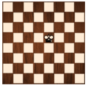

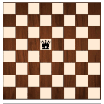
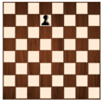
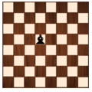
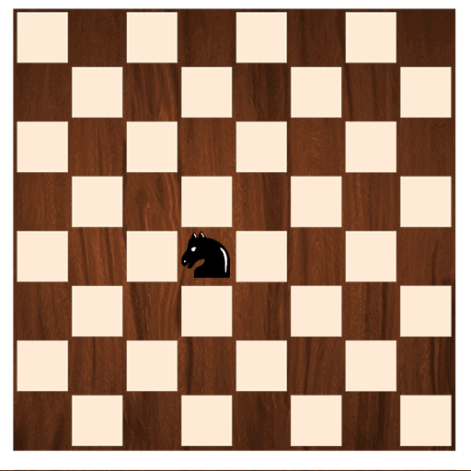
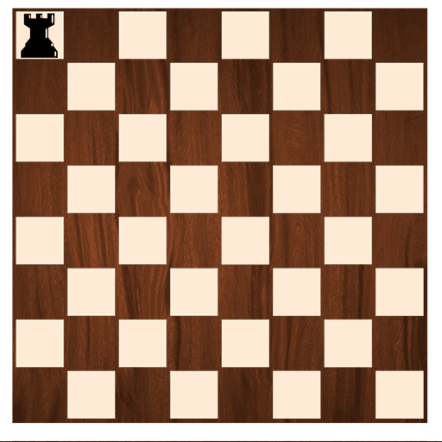
How do they move?
KING
QUEEN
PAWN
BISHOP
HORSE
CASTLE

Slide 81
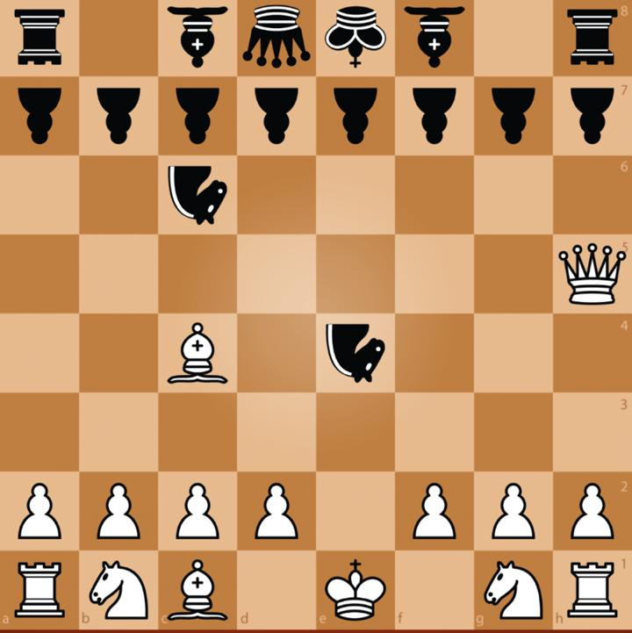
8
?

Slide 82
8
?

Slide 83
AWESOME!!!

Slide 84
CONGRATULATIONS!
YOU
HAVE
COMPLETED
THE
GAME!

